Slide 1
Vulcan Defect Status
Mar. 1, 2016
Tao Wu, Wen Yi Gao

Slide 2
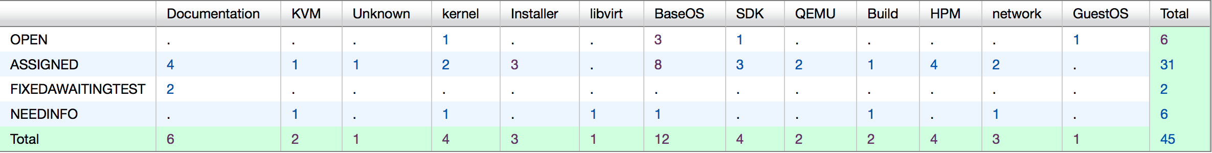
Vulcan - Open Defects
45 open defects exluding 22 HVM bugs..
13 defects new opened in the last two weeks. We solved 22 defects in the past two weeks.
Defect statistics:

Slide 3
Vulcan – High Priority Defects
No |  |  |  | Comp | Summary | Status | Comment
1 | 137694 | P1 | Ship issue | Build | License files for FP1 | NEEDINFO | Waiting updated license files for FP1 from MCP team.
2 | 137679 | P1 | High | BaseOS | sg_luns cannot display more than 1023 luns | ASSIGNED | -Fixed by increasing the size of internal buffer of sg_luns application. - Will discuss if we need to improve lsluns tool to display more luns in Metis
3 | 135585 | P1 | High | Installer | DNS specified during installer does not get set correctly on host | ASSIGNED | The Vulcan installer doesn't support VLAN configuraton currently. - Will implement it as an enhancement in Metis.

Slide 4
Vulcan – All Defects
396 defects excluding 115 HVM defects opened in the Vulcan Bugzilla until now.

